Slide 1
web-based property unit management system in bfar-mimaropa regional office
Proponents:
Maderazo, Justine Rafael B.
Llamoso, Aloha Chloe L.
Tabay, Renz Bryan

Slide 2
introduction
Web-based Property Unit Management System in BFAR-MIMAROPA Regional Office is designed to enhance overall organizational efficiency by providing a seamless flow of information. The Bureau of Fisheries and Aquatic Resources (BFAR) holds a crucial role in the sustainable management and development of the MIMAROPA's fisheries and aquatic resources. With a commitment to advancing operational efficiency and accountability, there is a pivotal focus on introducing an Inventory Management and Document Management System within the property section. The aim of this initiative is to transform the mechanisms governing inventory control, introducing a nuanced system for categorizing supplies.

Slide 3
Objectives of the study
The main objective of this study is to design, develop and implement an Web-based Property Unit Management System in BFAR-MIMAROPA Regional Office. Specifically, this study aims to:
develop a system that categorizes the supplies used and distributed by the BFAR;
develop a system that generates a document file regarding to the supplies that they used, distributed, and returned to them by the fisherfolks;
develop a system, generating reports and analytics regarding to the supplies and inventory handling and distribution;
optimize the return process, accurately recording and assessing damages, and facilitating collaboration between relevant departments to mitigate losses and maintain inventory integrity.
evaluate the performance of the developed system using ISO 25010.

Slide 4
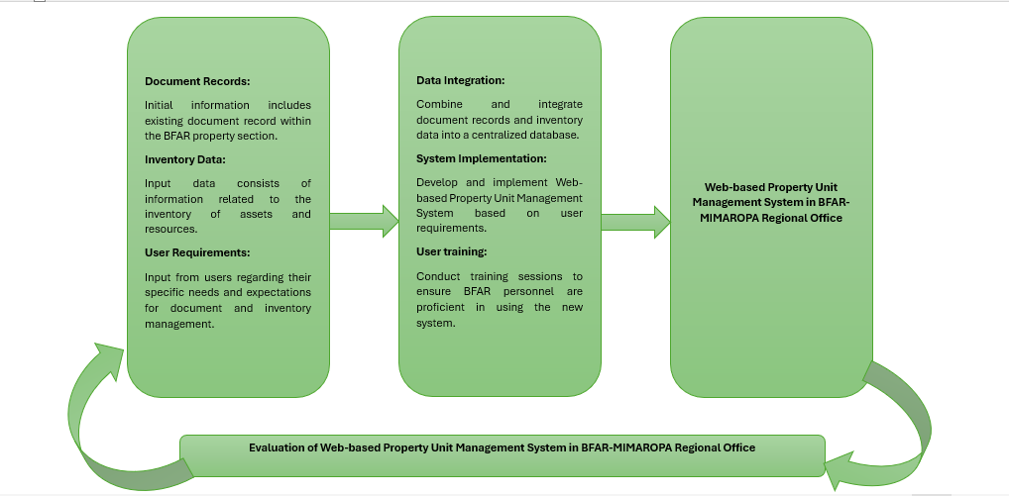
Conceptual framework

Slide 5
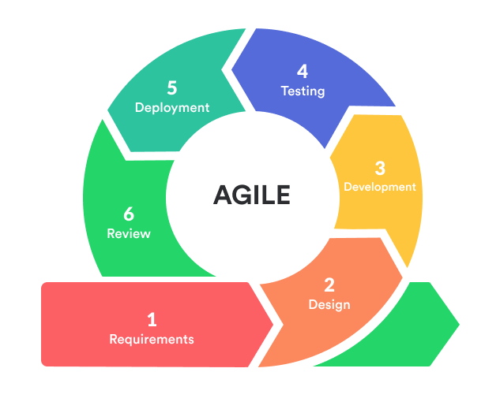
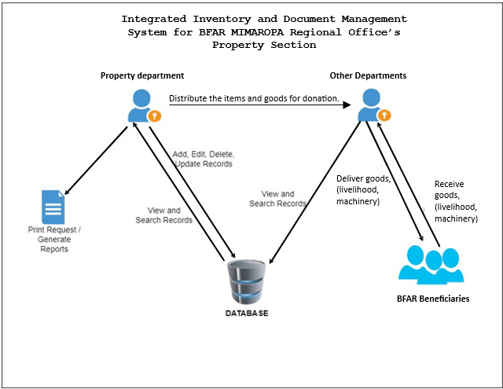
methods
Research Design
System Architechture

Slide 6
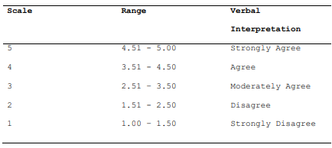
methods
LIKERT SCALE
QUESTIONNAIRES:

Slide 7
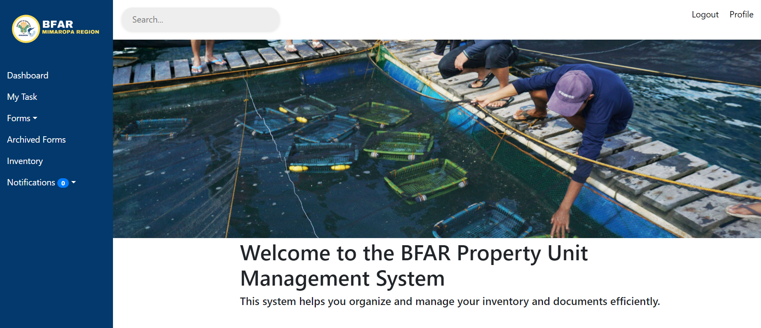
SYSTEM PRESENTATION

Slide 8
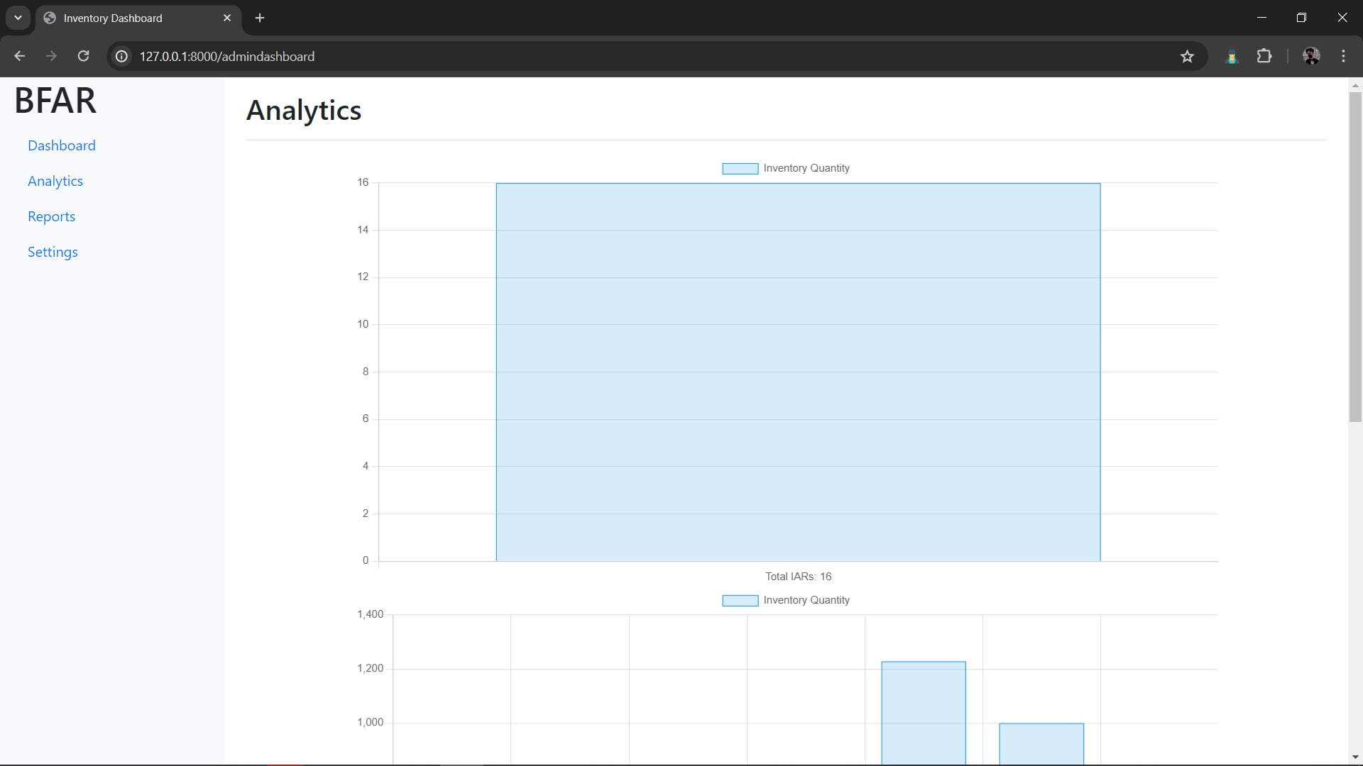
SYSTEM PRESENTATION

Slide 9
FEATURES
Supply Categorization
Document Generation
Reporting and Analytics System
Optimized Return Process
Item Tracking
ISO 25010 Compliance
User Authentication and Access Control
Data Security and Privacy

Slide 10
THANK YOU

